Slide 1



http://pingo.edu.vn/thiet-ke-website-bang-php-codeigniter/
PHP Frameworks
Git and Github
Web Applications in Hatch
Tuan Duong
http://pingo.edu.vn/tuan-duong/

Slide 2

Git whhaaat???
Is a source/version control management software.
Is a software that allows you to track the changes that you make to individual files.
git push
git pull
git commit

Slide 3

Github eeeeee??
is a web-based hosting service for software development projects that use the Git revision control system
“social coding”

Slide 4

Why u no use git and github??

Slide 5
Why u no use git and github??
Git can track your changes to your projects.
You can go back to a certain change you made that you want to recover.

Slide 6
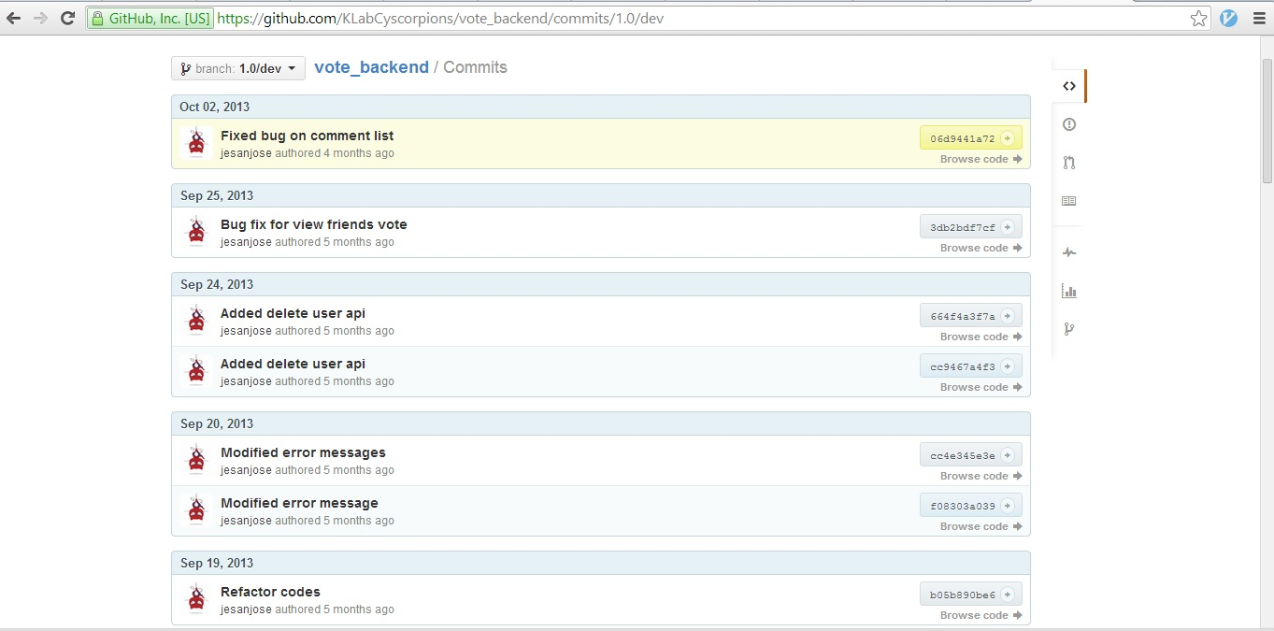
Why u no use git and github??

Slide 7
Why u no use git and github??
Github lets you collaborate with other developers or your project teammates by adding comments or suggestions on commits.
You can also contribute to public/open source projects. (eg. Facebook SDK, Codeigniter, PHP, etc...)
Share your codes to public and get feedback from large community of developers.

Slide 8
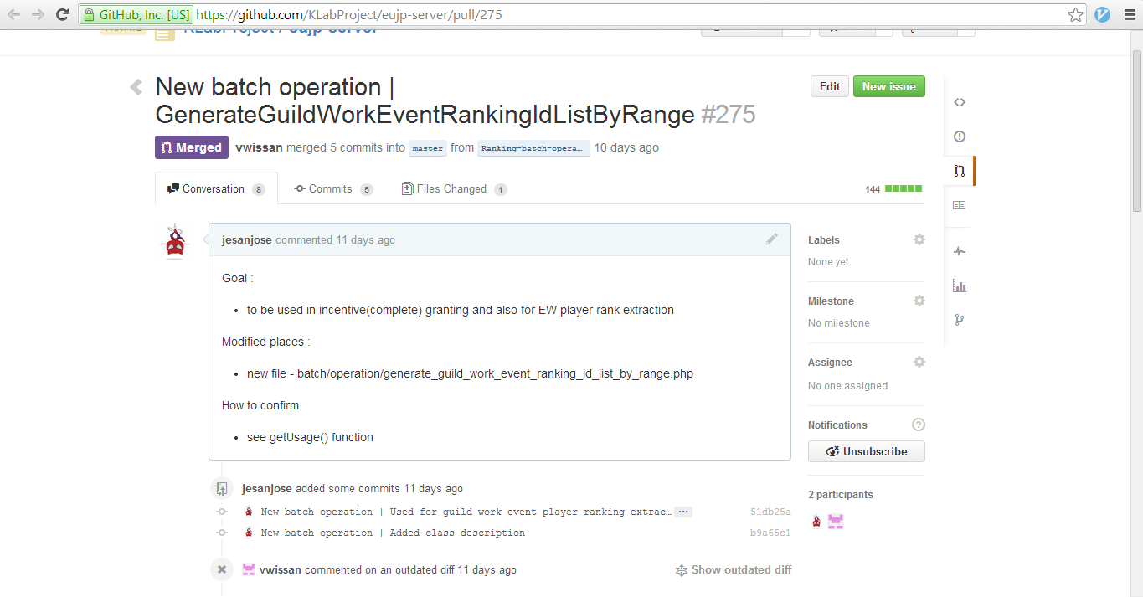
Why u no use git and github??

Slide 9
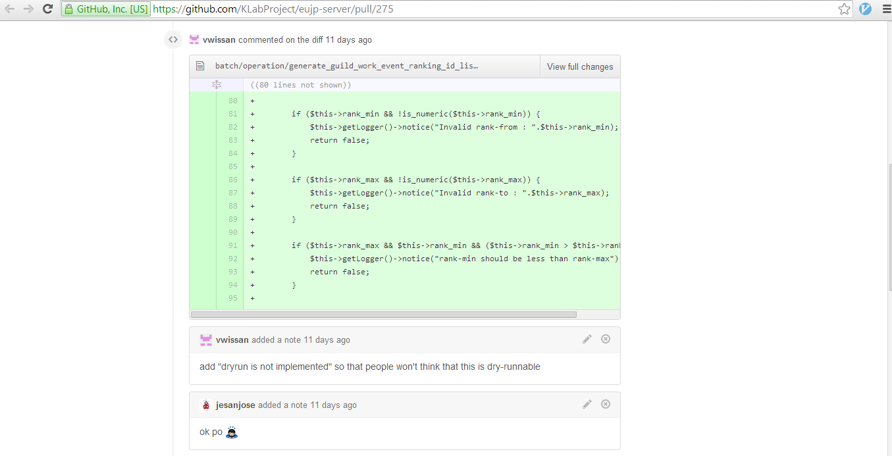
Why u no use git and github??

Slide 10
Commands Overview
git init
Initializes a git repository.
git status
Check your changes made (untracked files, modified files, staged files)
git commit
Save your changes into one commit history.
git push
Push your changes in the remote repository.
git pull
Pull changes from remote repository and apply it to your local repository.
git fetch
Fetch changes from remote repository but changes will not apply to your local repository

Slide 11

Git and Github
Git and github can be effectively used in project collaborations.
Can improve a developer’s coding.
Can avoid overriding or duplicating codes
Not just a developer tool

Slide 12

“Whenever you are asked if you can do a job, tell'em, Certainly, I can! Then get busy and find out how to do it.”
- Theodore Roosevelt

Slide 13
PHP Basics - Statements

